Slide 1

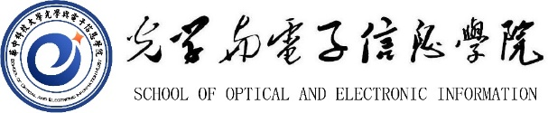
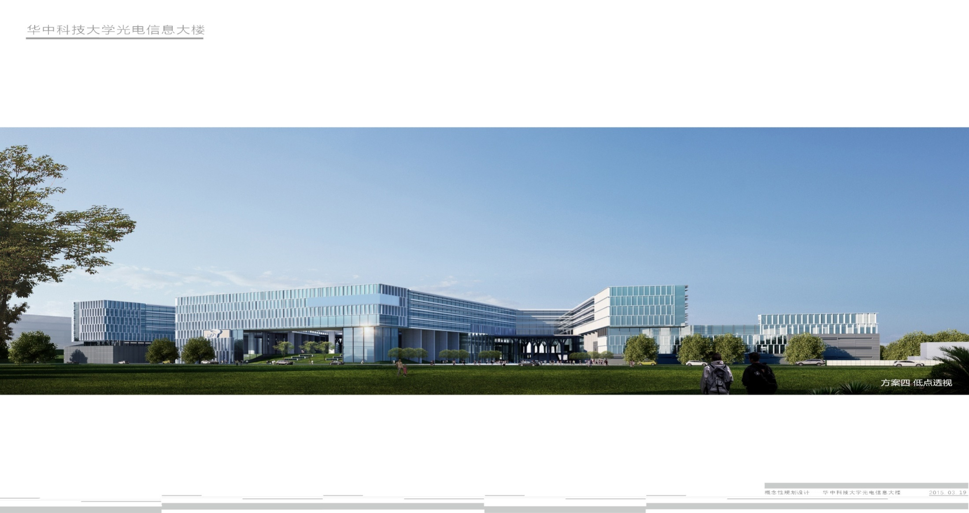
Paper sharing: EvDistill & Efficient Video Deblurring Guided by Motion Magnitude
Speaker :Ying Jie

Slide 2

Background Knowledge
1. Event-based Camera against with traditional camera
2. Knowledge Distillation
3. Multimodal

Slide 3
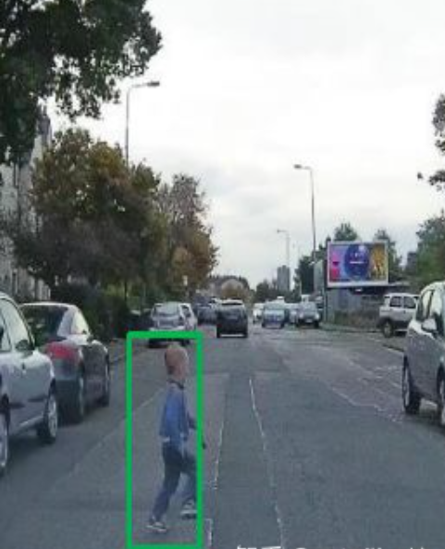
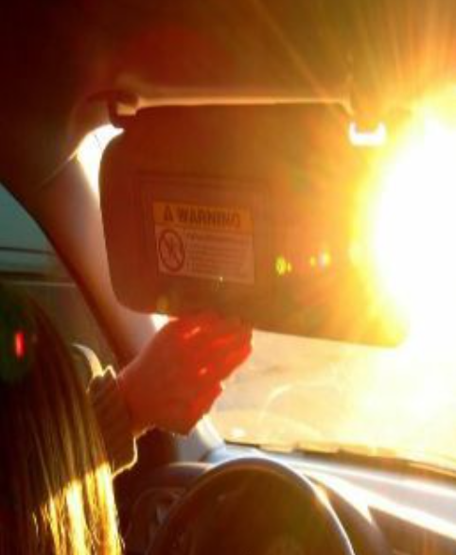
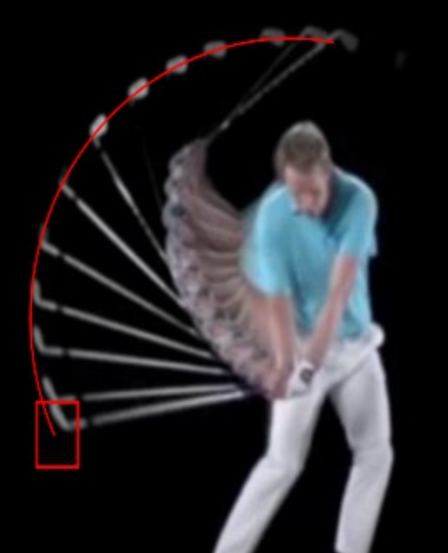
What’s the Event-based camera(EB)/Dynamic Vision Sensor(DVB) ?
traditional camera’s shortage:
frame rate
Conventional cameras achieve the "exposure" effect by accumulating a certain number of photons on the sensor, but this takes some time
Delay
causing the detection box to lag behind the pedestrian
Poor dynamic response
loss of information when the brightness is very high
Blurry
high speed sports cue shot not clear

Slide 4
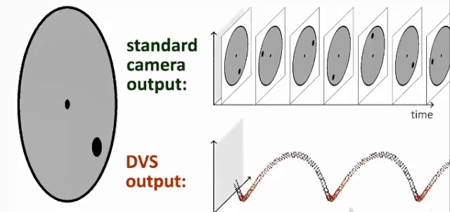
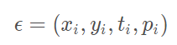
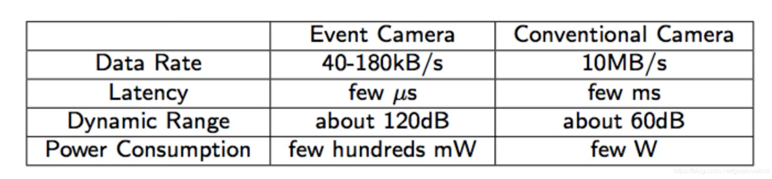
Improve the traditional camera —— EB!
Three factors of a event：
Timestamp,
pixel coordinates,
polarity
take photos when intensity changes

Slide 5
Application of event-based camera
Advantages:
1.low time latency and high dynamic range
2. The need for data storage and computing resources is relatively small
3. Record clearly at night and in bright light
Disadvantages:
1. Not valid at absolute rest
2. Too fast will cause noise and even errors
1. Advanced or current sensing algorithms have matured but are not robust enough.
—— when dealing with the delayed images taken by traditional camera
It has a higher dynamic range, which means that event cameras can be used in intelligent sensing applications such as drones and unmanned vehicles

Slide 6
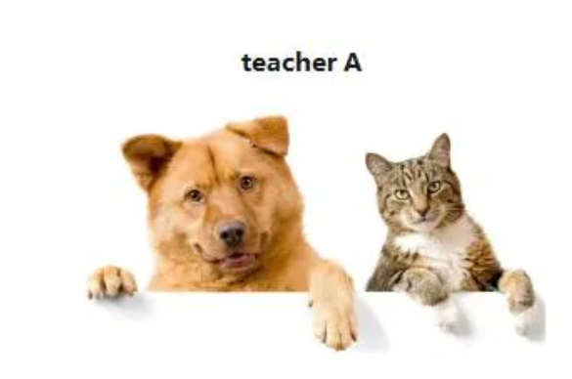
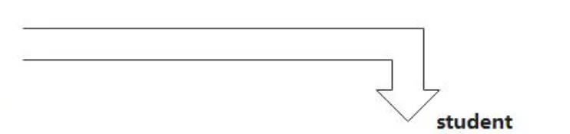
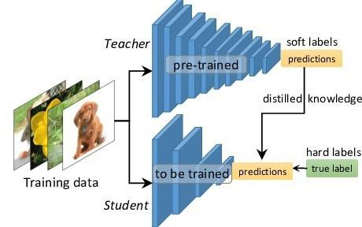
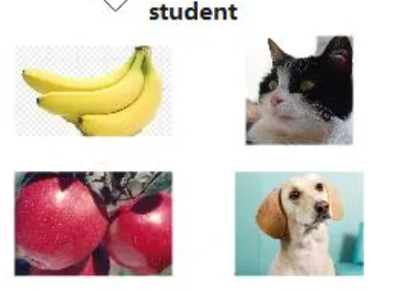
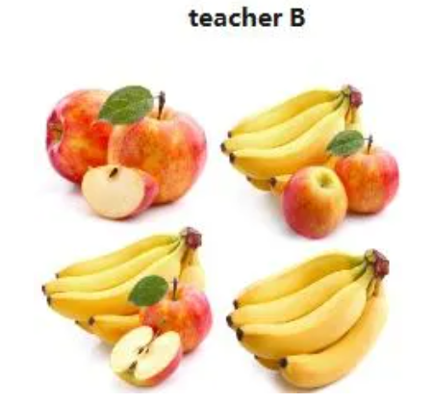
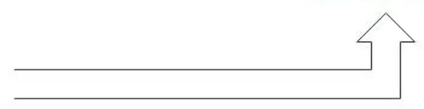
Knowledge Distillation
Image domain transfer training

Slide 7
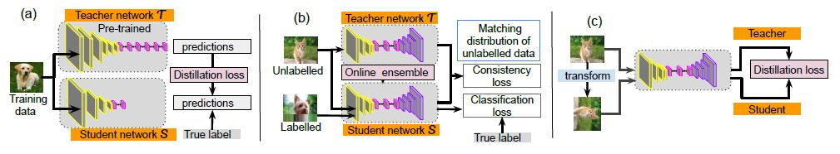
Knowledge Distillation
Classification:
(a)Offline distillation
(b)Semi-supervised distillation
(c)Self supervised distillation

Slide 8
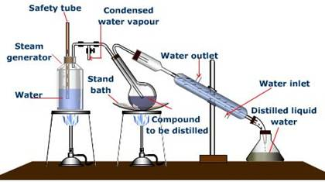
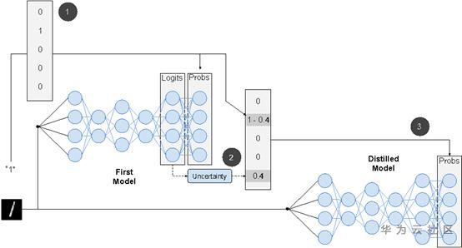
Knowledge Distillation’s Principle - Diffrence between two meanings
Steam Distiller(In the sense of chemistry)
Knowlede Distiller(In the sense of DNN)
· The distilled liquid is a mixture
· The original model contains a lot of knowledge
· The boiling point of each component is different. The distillation temperature should be set according to the boiling point of the target substance
· The temperature T is added to ensure that the information is not lost when the information entropy is too small
Generally, when distillation is used, a student network with a smaller number of parameters is often found, so compared with teacher, this lightweight network is unable to learn the latent relationship hidden before the data set, as shown in the figure above. Compared with the output of one hot, teacher network is to softmax the logits output, processing the label more smoothly, that is, the number 1 output into 0.6 (prediction of 1) and 0.4 (prediction of 0) and then input into the student network, compared with 1, this kind of softmax contains more information. The goal of a good model is not to fit training data, but to learn how to generalize to new data. Therefore, the goal of distillation is to let students learn the generalization ability of teacher, and theoretically the results will be better than those of students who simply fit the training data. In addition, for the classification task, if the entropy of soft targets is higher than that of hard targets, it is obvious that students will learn more information. Finally, what the student model learns is the generalization ability of the teacher model, rather than "overfitting training data".

Slide 9
Why we choose to use Knowledge Distillation?
In some way,Knowledge Distillation can help reduce the cost of your computationally expense
1. Improve model accuracy
2. Reduce model delay and compress network parameters
3. Domain migration between tags
Deep learning has achieved incredible performance in many fields such as computer vision, speech recognition, and natural language processing. However, most models are too computationally expensive to run on mobile or embedded devices. Therefore, it is necessary to compress the model, and knowledge distillation is one of the important techniques in model compression.

Slide 10
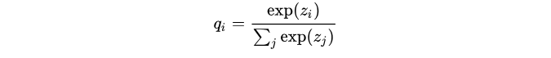
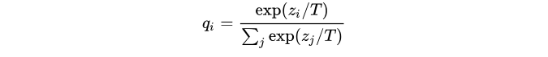
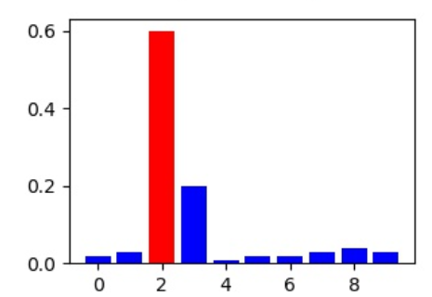
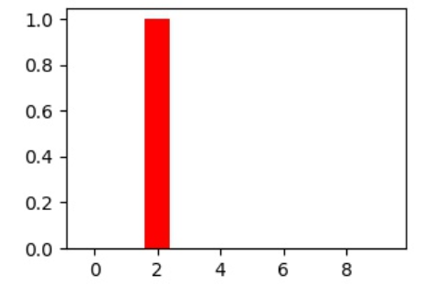
Knowledge Distillation - Function 1
The function of knowledge distillation:
Soft-max function
softmax with temperature added
The probability vector$z_{i} ,z_{j}$ is softened here（soft target）

Slide 11
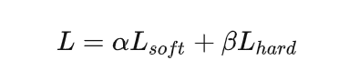
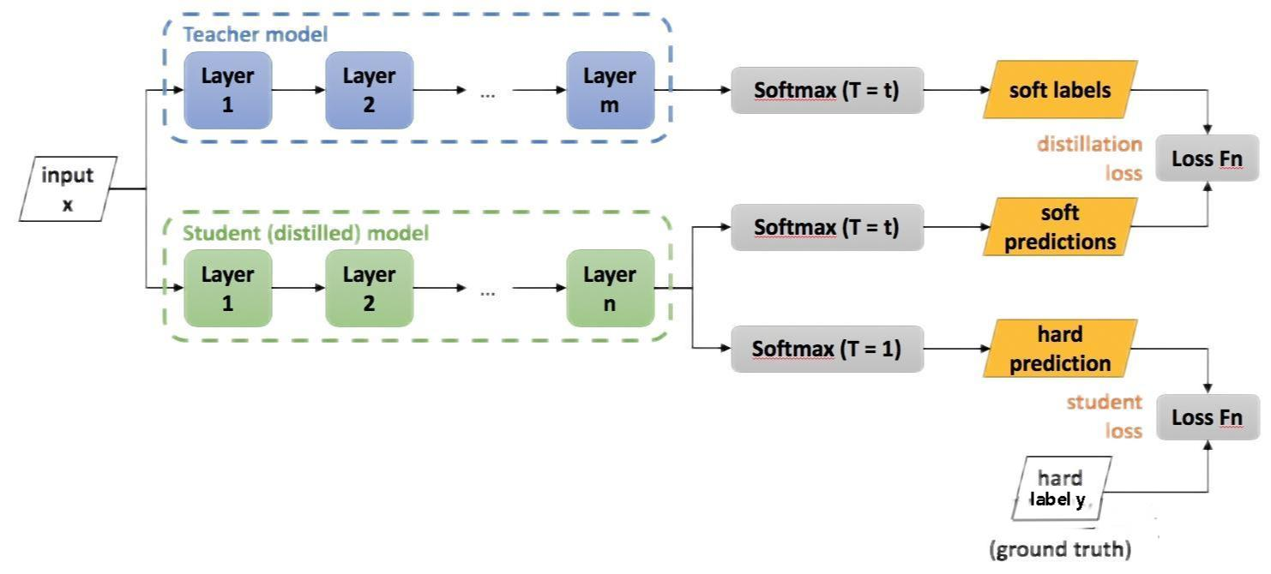
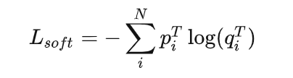
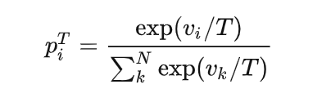
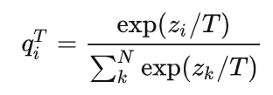
Knowledge Distillation - Function 2
How could we train the teacher NN?
v - teachers’ logisitics
z - students’ logistics

Slide 12
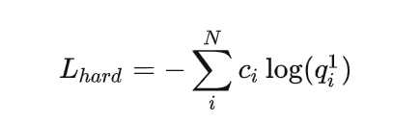
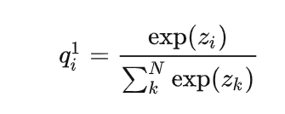
Knowledge Distillation - Function 3
How could we return student’s loss?
$$c_{i} refers to ground truth,c_{i}∈\{0,1\}$$

Slide 13
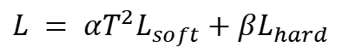
Knowledge Distillation - Function 4
How could we return student’s loss?
from Hinton’s paper(2015,put forward Knowledge Distillation for first time)
$$when L_{hard} is small,can have the best effect(An empirical conclusion)$$
Contribution to the gradient of $L_{soft} probably equals to L_{hard} times \frac{1}{T^{2}}$
$$L = αT^{2}L_{soft}+βL_{hard}$$

Slide 14
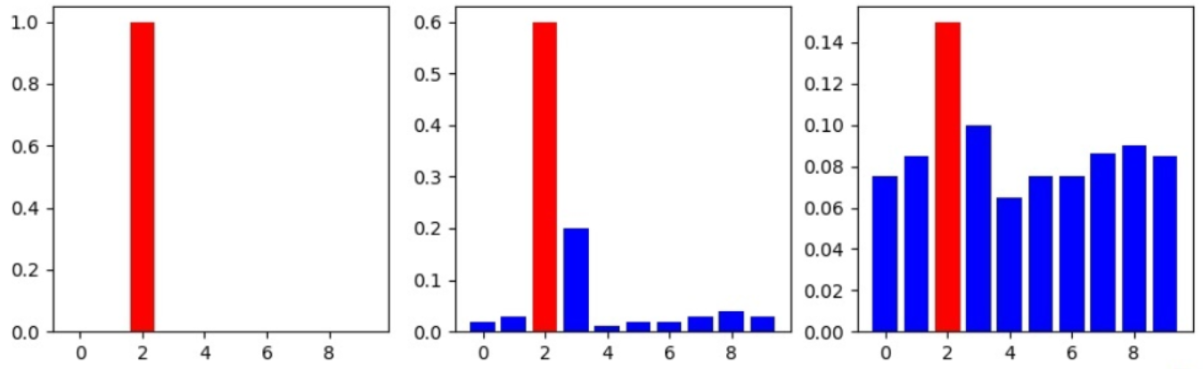
Knowledge Distillation - About “T”
T = 1(Original case)
T < 1
T > 1
When T ,the output distribution of softmax will become increasingly flat, and the information entropy will become increasingly large
T = 1(Original case, or view it as a special point at T equals 0)

Slide 15
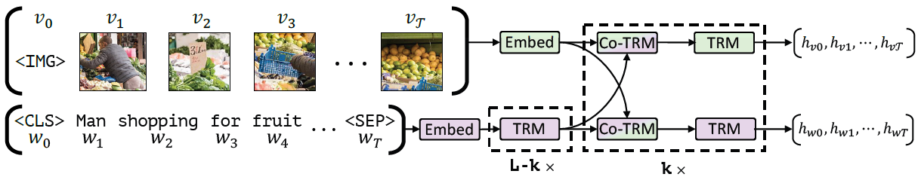
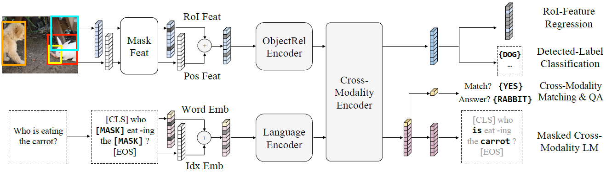
Multimodal/Cross-modal & it’s Pretrain
What’s the multimodal?
Use just a model to achieve multiple feature extraction.
Examples:
ViLBERT:
LXMERT:

Slide 16
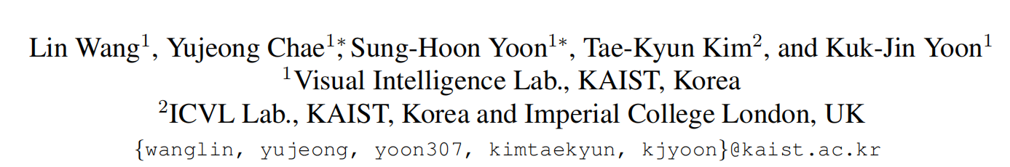
EvDistill: A Reconstruction-guided Cross-modal Knowledge Distillation
# Paper Abstract：
1. Provenance：CVPR 2021
2. Author：
(Visual Intelligence Lab)
3. Cites：16+（According to incomplete statistics）
Goal:
This paper discusses how to train Event data with traditional image data on knowledge distillation.
By proposing the bidirectional mode module of BMR, the paper points out that the image is reconstructed from the event, and the event is reconstructed from the image, and the data association is realized.
Then the segmentation task is realized by neural network.

Slide 17
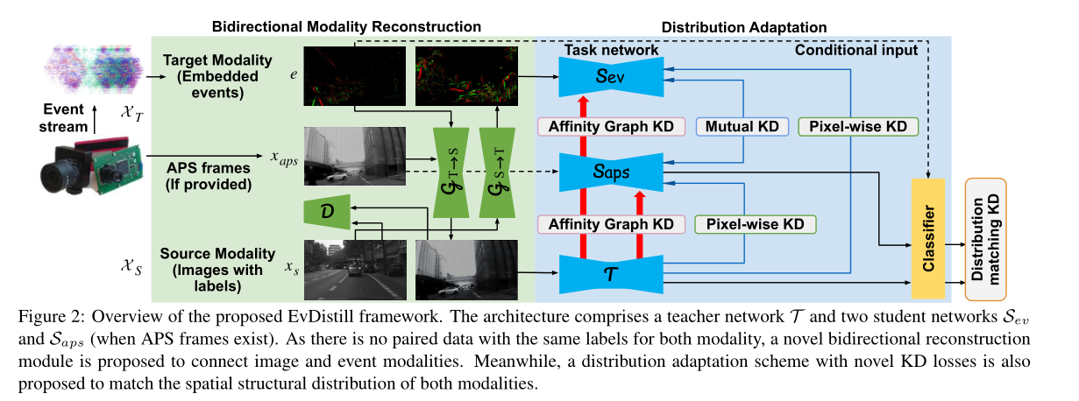
EvDistill: A Reconstruction-guided Cross-modal Knowledge Distillation
3. How to build KD loss?
1. How unpaired data could connected?
2. Difficult to extract knowledge from similar spatial structures
(APS: Advanced Photo System - Digital writing ability - traditional camera’s function)

Slide 18
Three main problems mentioned in the paper
1. How unpaired data could connected?
A bidirectional reconstruction module is proposed to connect the two modes.Then simultaneously use them to extract knowledge through the constructed pairs.(3.2)
2. Difficult to extract knowledge from similar spatial structures
A distributional adaptation scheme that adapts knowledge by matching the class distributions of two modes.
3. How to build KD loss?
Propose a new affinity diagram KD loss and other loss terms are used to learn better SEVs.

Slide 19
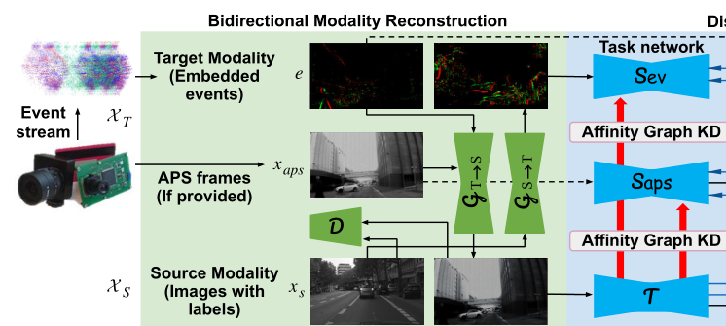
To solve P1: Bidirectional modal reconstruction
(BMR)
Generator GT→S :
converts the event into an intermediate representation of the image mode
GS→T:
converts the labeled image data into an intermediate representation of the event mode.
pw:pixel waste?
Adversarial losses :
(for example, modes from target to source)

Slide 20
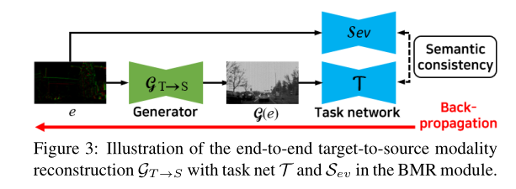
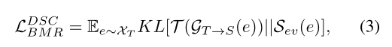
To solve P1: Bidirectional modal reconstruction
(BMR)
KL(·||·):KL divergence between two distributions

Slide 21
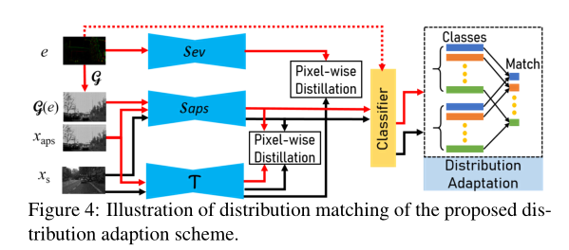
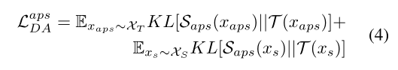
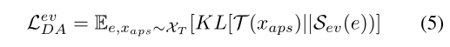
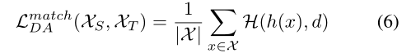
To solve P2: Matches the class category distribution between two patterns
Predicted - matching loss :
The distillation loss is used to guide student Sev to behave more like teacher T based on event e :
h: x→{0,1} as a classifier

Slide 22
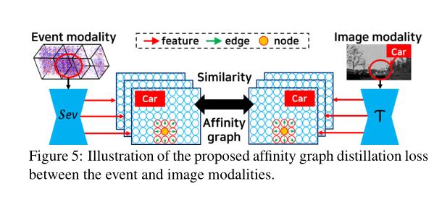
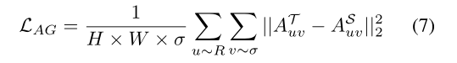
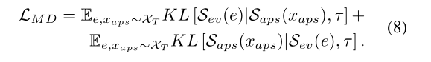
To solve P3:Affinity Graph KD and Other KD Losses
In summary, the objective L of EvDistill is as follows :

Slide 23
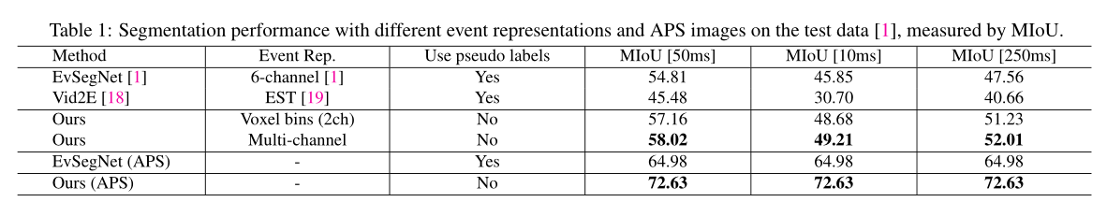
EvDistill: Experiment and Evaluation
Dataset:the publicly available driving scene dataset DDD17

Slide 24
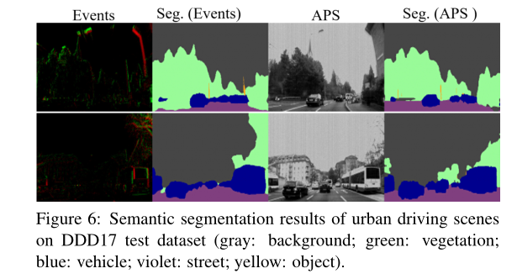
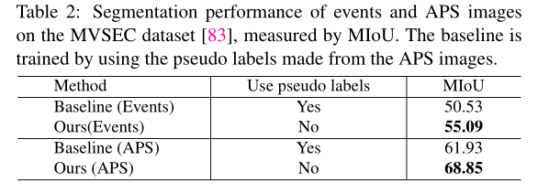
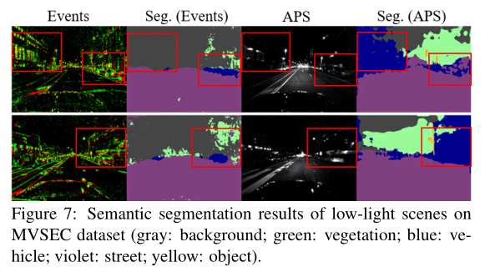
EvDistill: Experiment and Evaluation

Slide 25
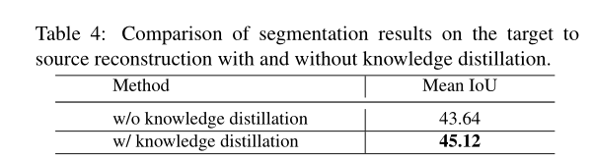
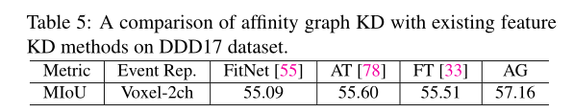


EvDistill: Ablation Study and Analysis

Slide 26
EvDistill: Model summary & Evaluation
Advantsges:
1. use a BMR module to bridge both modalities,which contains excellent feature extraction effect
2. Besides, a novel graph affinity KDto enhance the KD performance.
3. The experiments on two end-tasks demonstrate the effectiveness of this method.
Disadvantages:
1. Could only used in corresponding cities which matches the datasets
2. Inference latency is inevitable

Slide 27
EvDistill: A Reconstruction-guided Cross-modal Knowledge Distillation
Some preconceived mathematical notation:
(u,t,p) : The events stream which is recorded by the event camera

